Slide 1
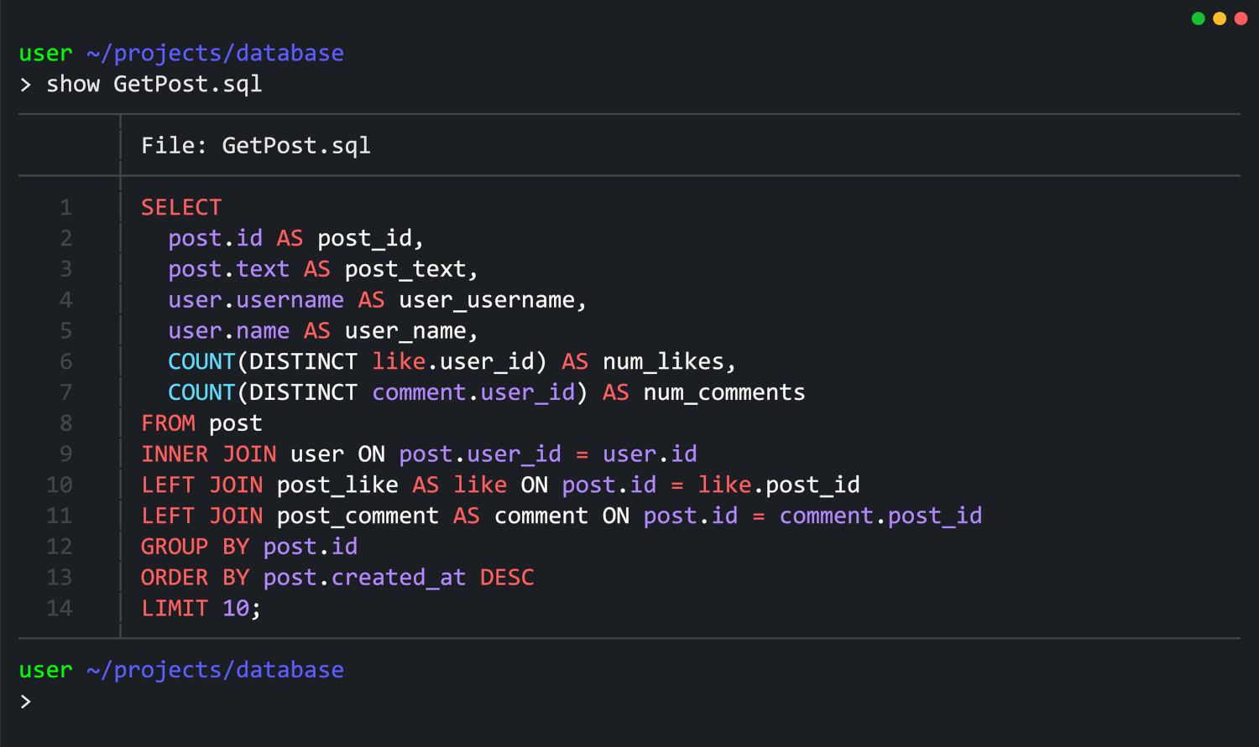
MySQL

Slide 2


Database

Slide 3
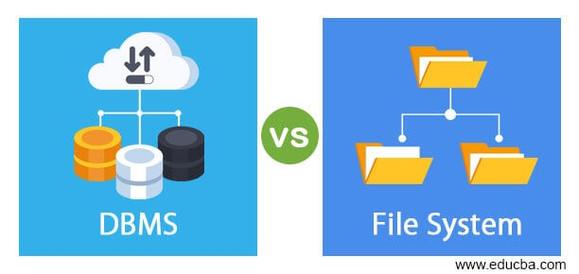
Database
A database is an organized collection of structured information, or data, typically stored electronically in a computer system. It is designed for efficient storage, retrieval, and management of large amounts of information

Slide 5


Slide 6
First Generation – Navigational Databases (1960s–early 1970s):
Hierarchical (e.g., IBM IMS): Tree-like structure, efficient but rigid.
Network (e.g., CODASYL): More flexible with multiple relationships, but complex to navigate.
Second Generation – Relational Databases (1970s–Present):
Based on E.F. Codd’s relational model (1970) emphasizing tables and set theory.
Relational Prototypes (1970s):
IBM’s System R and UC Berkeley’s INGRES demonstrated practical relational databases.
Commercial RDBMS (Late 1970s–1980s):
Vendors like Oracle, IBM DB2, and Ingres led market adoption.
SQL Standardization (1980s):
SQL became the standard query language, enhancing usability and interoperability.
Key Innovations in RDBMS:
Features like data independence, ACID properties, and normalization improved reliability and structure.

Slide 7
M
B
Dominance of Relational Databases:
Became the default for structured data and remain widely used.
Third Generation – Object-Oriented & Object-Relational Databases (1980s–1990s):
Attempted to bridge the gap between object-oriented programming and databases; limited mainstream success.
Fourth Generation – NoSQL (Late 2000s–Present):
Designed for scalability and flexibility with unstructured data; includes document, key-value, column-family, and graph databases.
NewSQL Databases:
Combine NoSQL scalability with relational features and ACID compliance.
Cloud & Distributed Databases (2010s–Present):
Managed by cloud providers with built-in scalability, availability, and maintenance.
Modern Trends:
In-memory databases for speed, and data lakes/warehouses for analytics and big data storage.
D
S

Slide 8


D
B
M
S

Slide 9
Database
D
B
M
S

Slide 10
Data Security
Data Integrity
A Database Management System (DBMS) is a software system that enables users to define, create, maintain, and control access to the database. It acts as an interface between the database (the actual data) and the end-users or application programs.
Backup & Recovery
Data Manipulation
Data Definition
Data Abstraction
Concurrency Control
Performance Optimization

Slide 11
Data Security
Data Integrity
Backup & Recovery
Data Manipulation
Data Definition
Data Abstraction
Concurrency Control
Performance Optimization

Slide 12
RDBMS

Slide 13

RDBMS
DBMS

Slide 14
Data Storage Structure:
DBMS: Stores data in various formats, often as files or in hierarchical/network structures.
RDBMS: Stores data exclusively in tables (rows and columns) with a strict, organized structure.
Data Relationships:
DBMS: Generally, does not enforce or easily manage relationships between different pieces of data.
RDBMS: Explicitly defines and enforces relationships between data in different tables using keys.
Data Integrity & Consistency:
DBMS: Offers limited mechanisms to ensure data accuracy and consistency.
RDBMS: Provides strong features (like ACID properties and constraints) to guarantee data integrity and reliability.

Slide 15
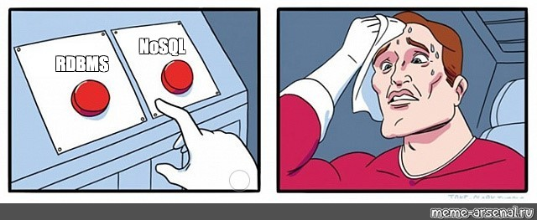

Slide 16
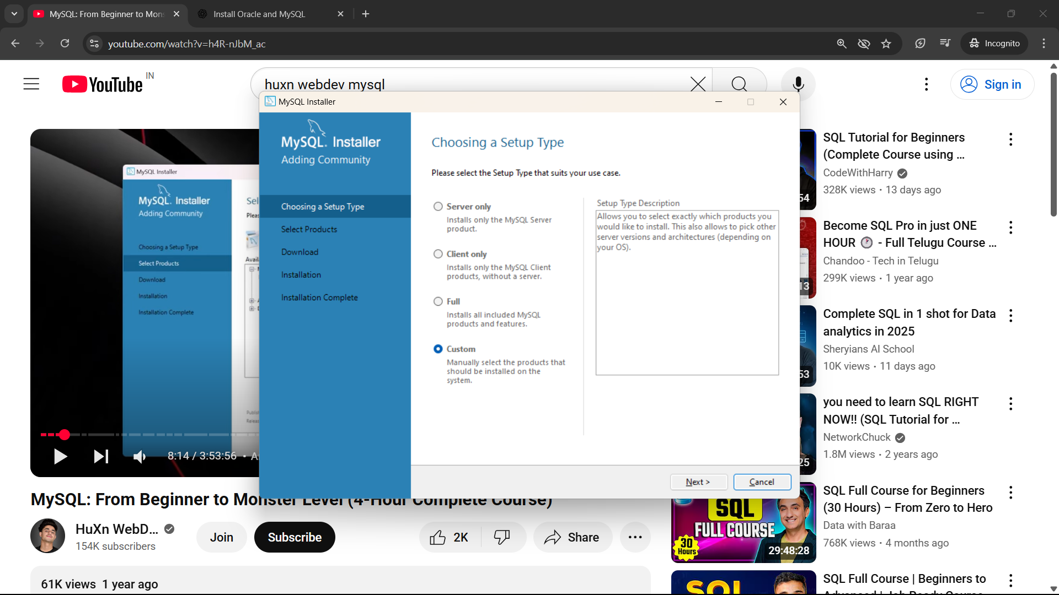
How to Install MySQL

Slide 17
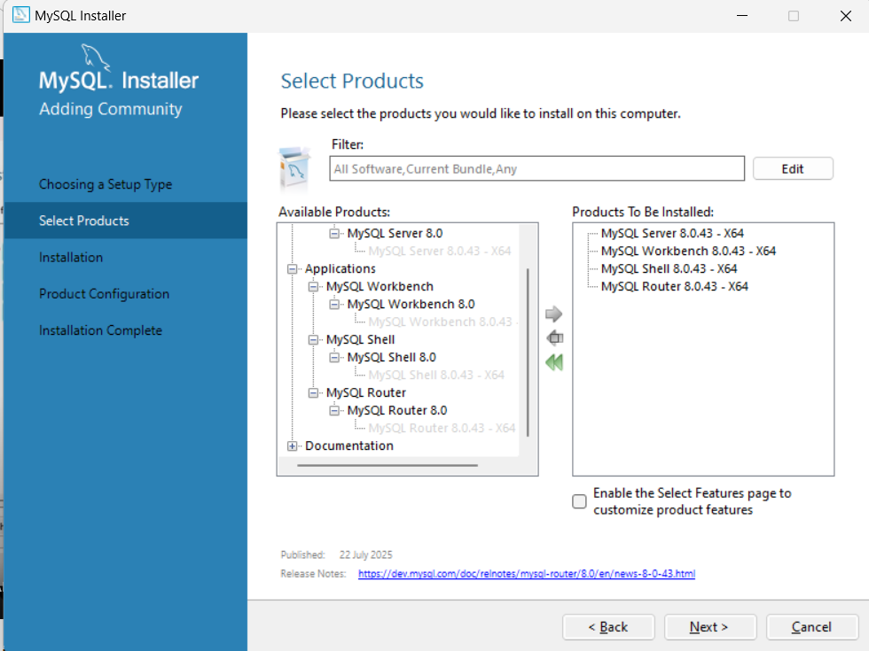

Slide 18
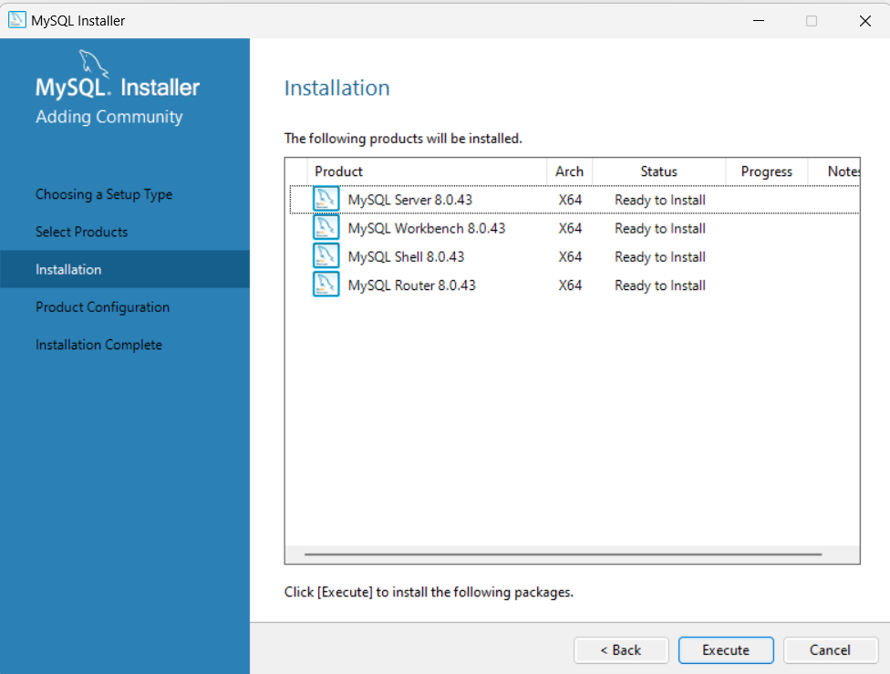

Slide 19
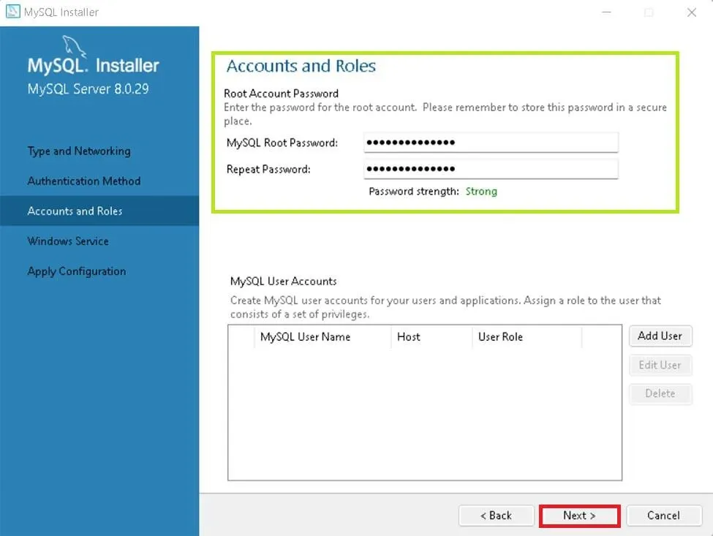

Slide 20
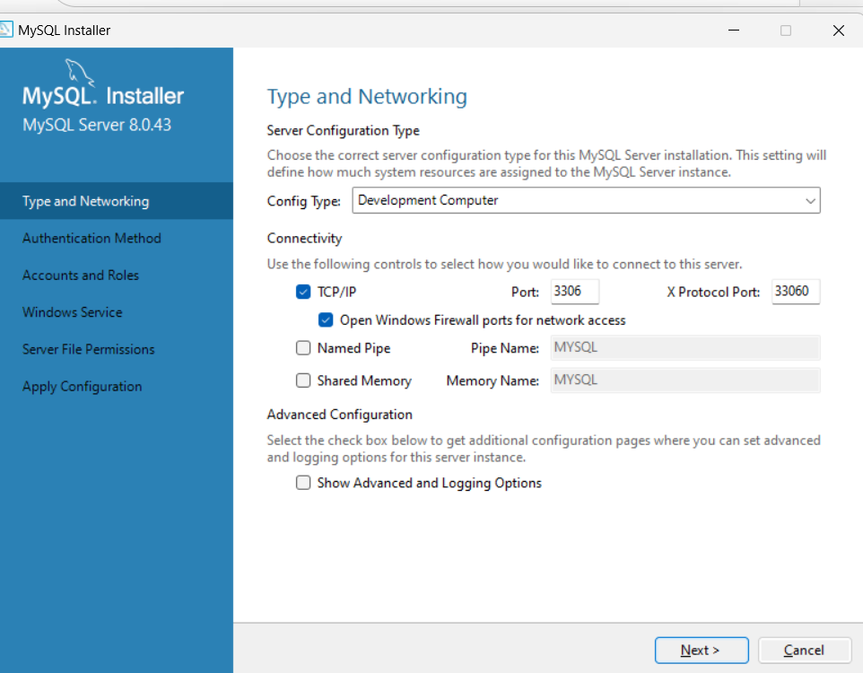

Slide 21
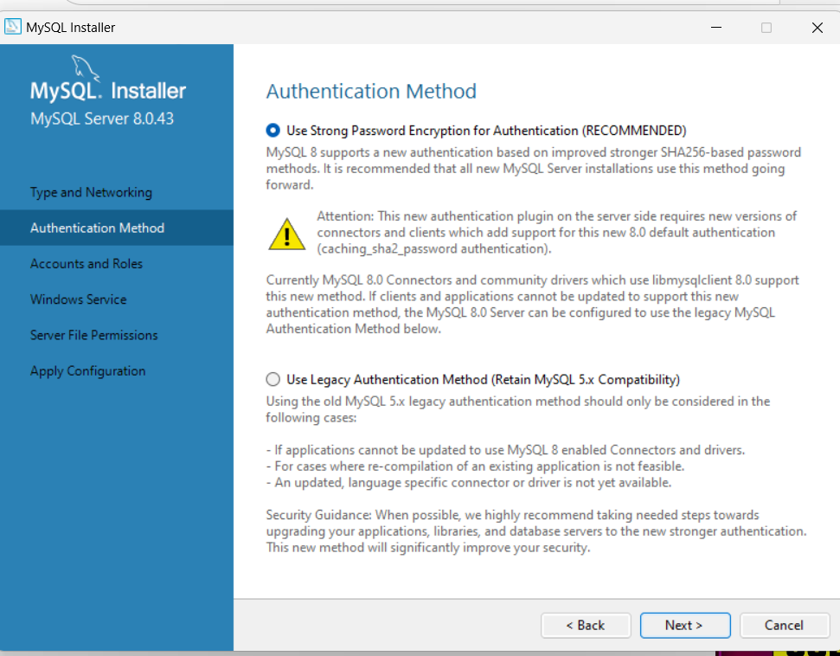

Slide 22
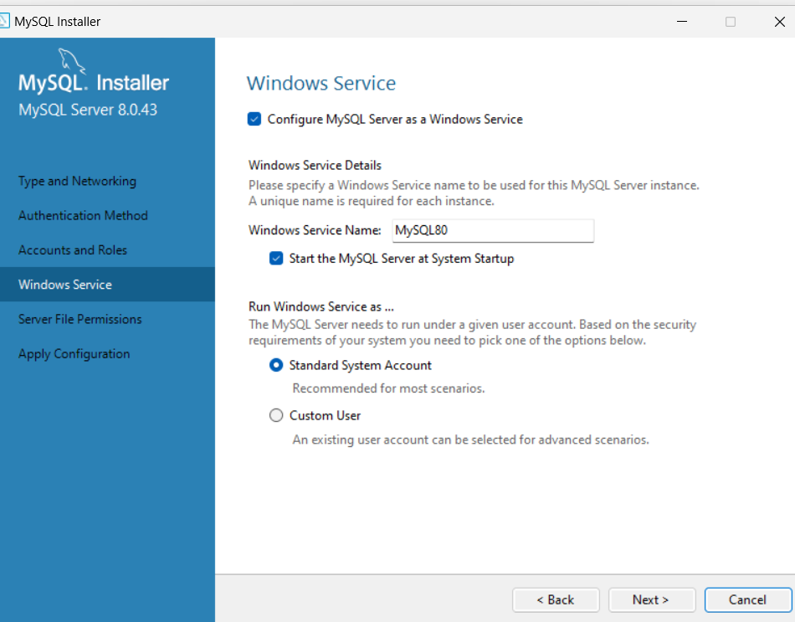

Slide 23
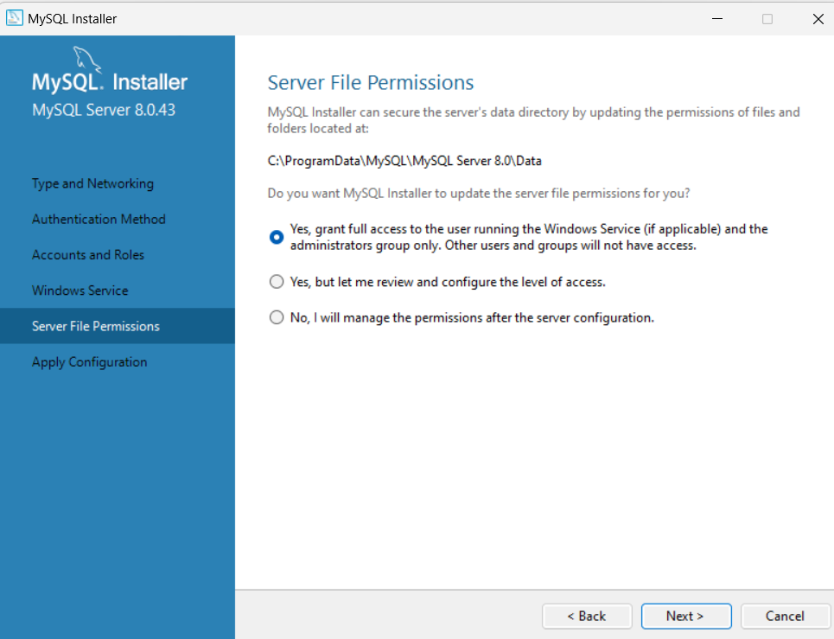

Slide 24


Slide 25
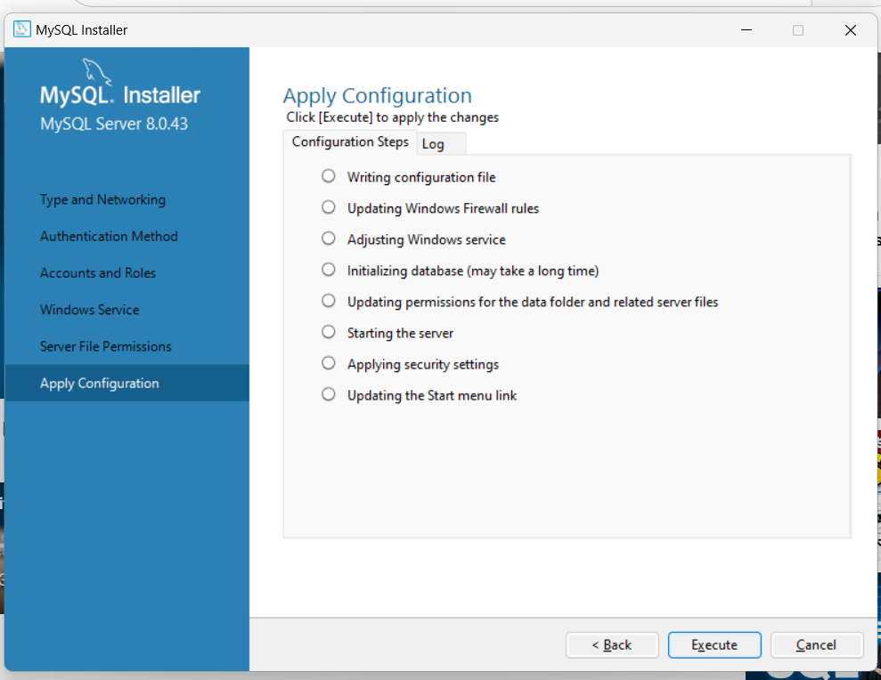

Slide 26
Database Commands

Slide 27
Database Commands
1. CREATE DATABASE Purpose: Creates a new database. 🔹 Syntax: CREATE DATABASE database_name; 🔹 Example: CREATE DATABASE SchoolDB;

Slide 28
2. SHOW DATABASES
2. SHOW DATABASES Purpose: Displays all available databases. 🔹 Syntax: SHOW DATABASES; 🔹 Example: SHOW DATABASES;

Slide 29
3. USE
3. USE Purpose: Selects a specific database to work with. 🔹 Syntax: USE database_name; 🔹 Example: USE SchoolDB;

Slide 30
4. SHOW TABLES Purpose: Displays all tables in the current database 🔹 Syntax: SHOW TABLES; 🔹 Example: SHOW TABLES;

Slide 31
5. CREATE TABLE Purpose: Creates a new table in the current database. 🔹 Syntax: CREATE TABLE table_name (
column1 datatype constraints,
column2 datatype constraints,
...
); 🔹 Example: CREATE TABLE Students (
StudentID INT PRIMARY KEY,
Name VARCHAR(100),
Age INT,
EnrollDate DATE
);

Slide 32
6. SHOW TABLE STATUS Purpose: Displays detailed information about tables in the database. 🔹 Syntax: SHOW TABLE STATUS;

Slide 33
7. DROP DATABASE Purpose: Deletes the entire database permanently. 🔹 Syntax: DROP DATABASE database_name; 🔹 Example: DROP DATABASE SchoolDB;

Slide 34
Data Types

Slide 35
Data Types
INT (Integer)
Used for: Whole numbers (positive or negative).
Syntax: column_name INT Example: Age INT UNSIGNED;

Slide 36
2. VARCHAR(n) (Variable-length String)
Used for: Text fields of variable length (e.g., names, emails). Syntax: column_name VARCHAR(n) Example: Email VARCHAR(100);

Slide 37
3. DECIMAL(p, s) (Fixed-point Number)
Used for: Precise numeric values (e.g., money, percentages). Syntax: column_name DECIMAL(p, s)
p = precision (total number of digits) s = scale (digits after the decimal point) Example: Salary DECIMAL(10,2); -- e.g., 12345678.90

Slide 38
4. DATE
Used for: Storing calendar dates (YYYY-MM-DD format). Syntax: column_name DATE Example: HireDate DATE DEFAULT CURRENT_DATE();

Slide 39
CHAR(n) (Fixed-length String
Used for: Short strings of consistent length (e.g., gender, country codes). Syntax: column_name CHAR(n) Example: Gender CHAR(1) CHECK (Gender IN ('M', 'F'));

